Slide 1
Sales analysis
File created on: 2/28/2025 7:31:35 AM

Slide 2
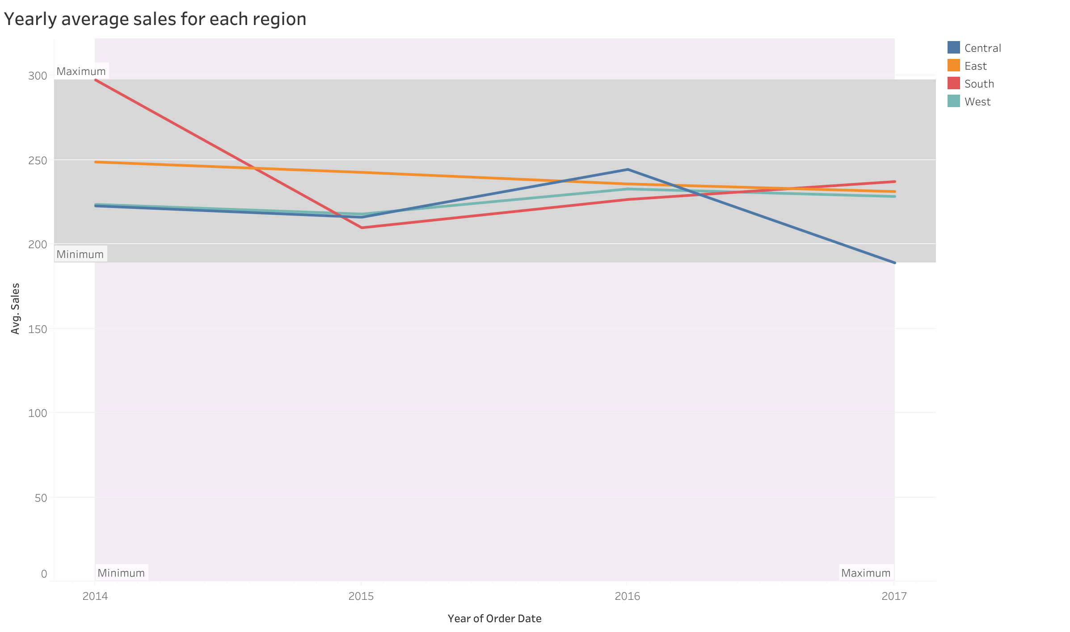

Slide 3
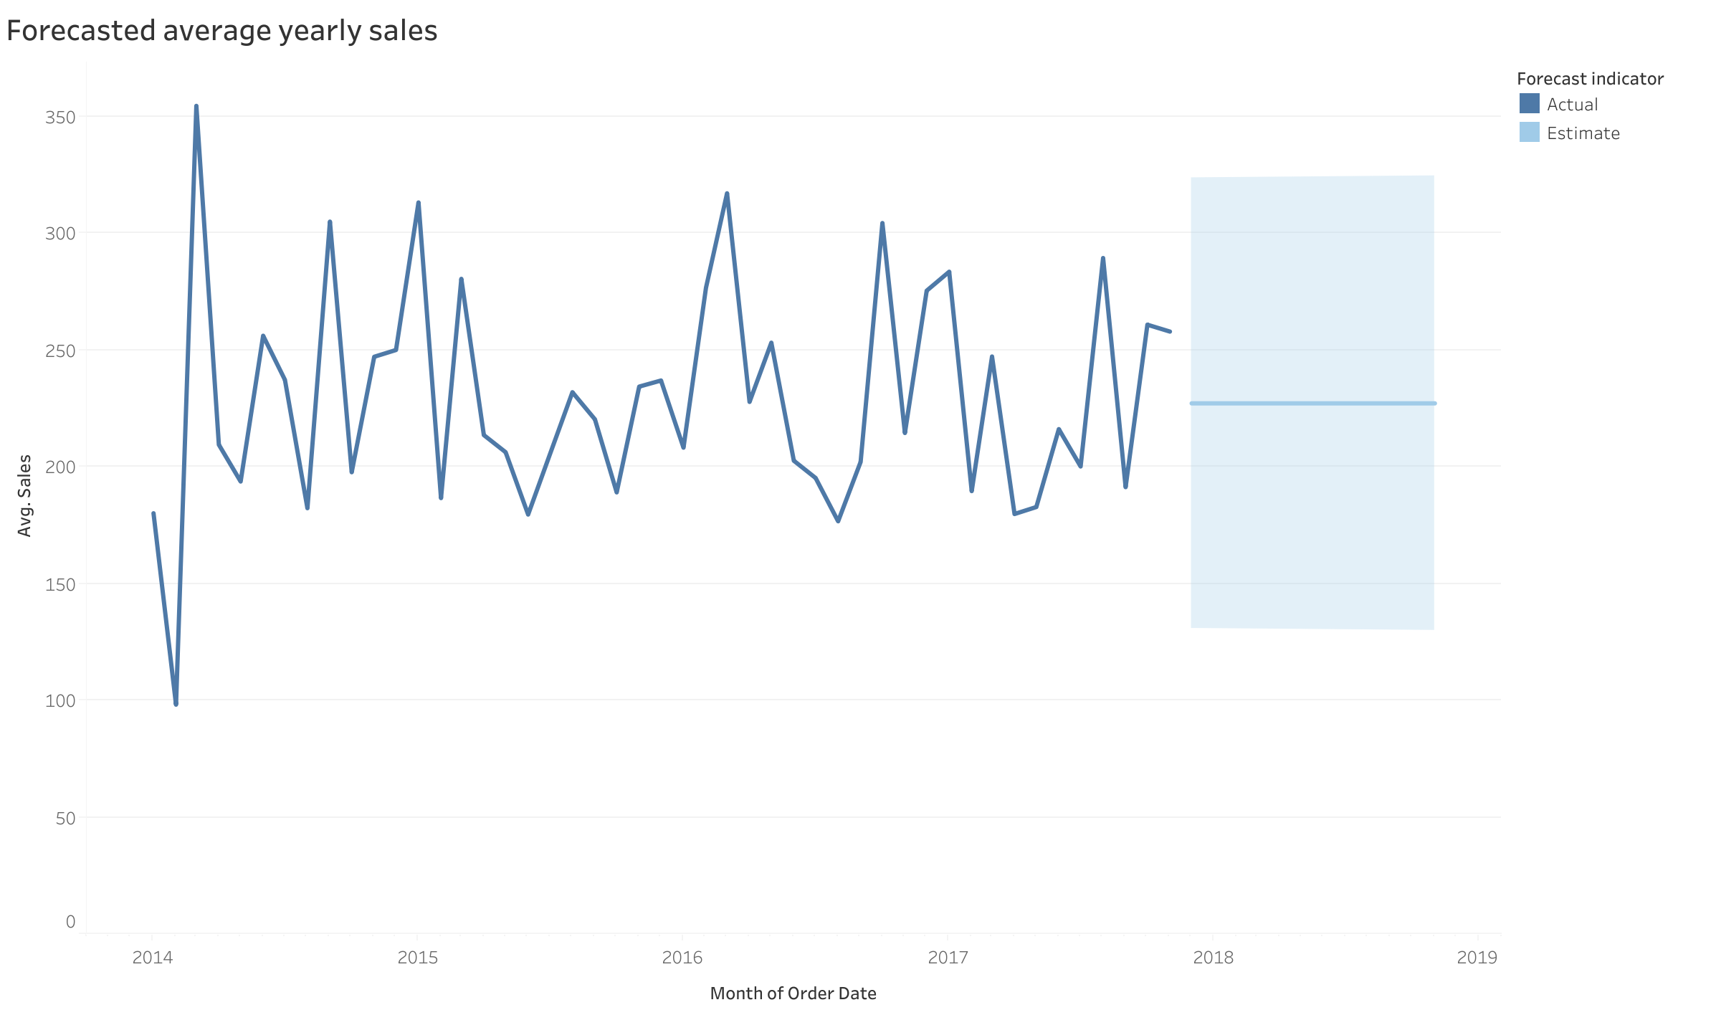

Slide 4
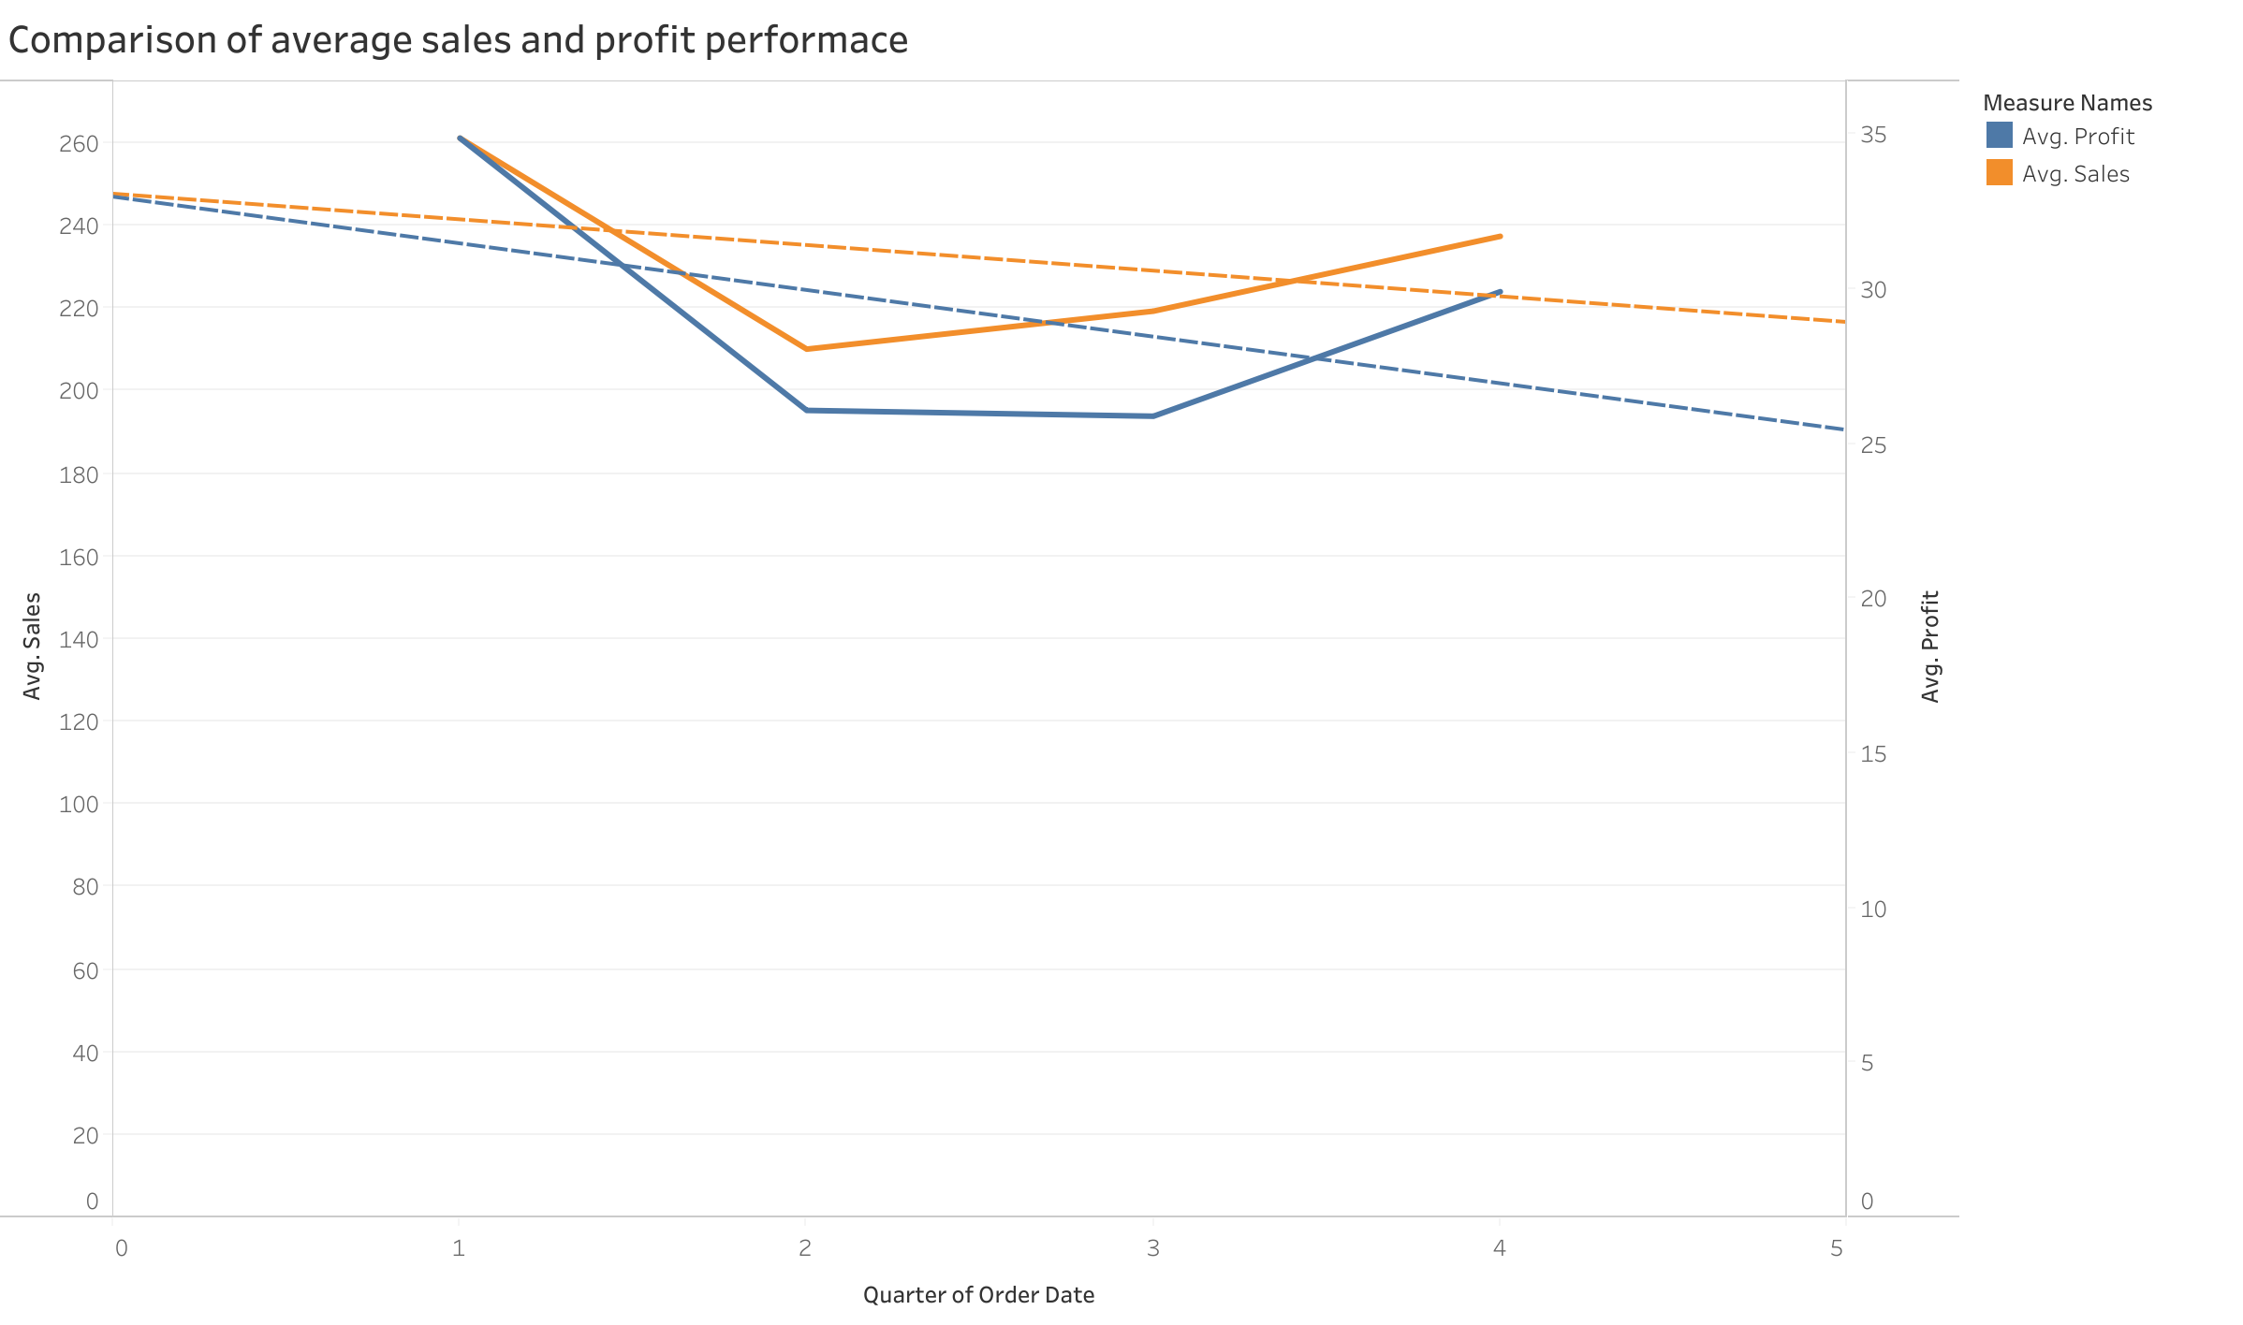

Slide 5
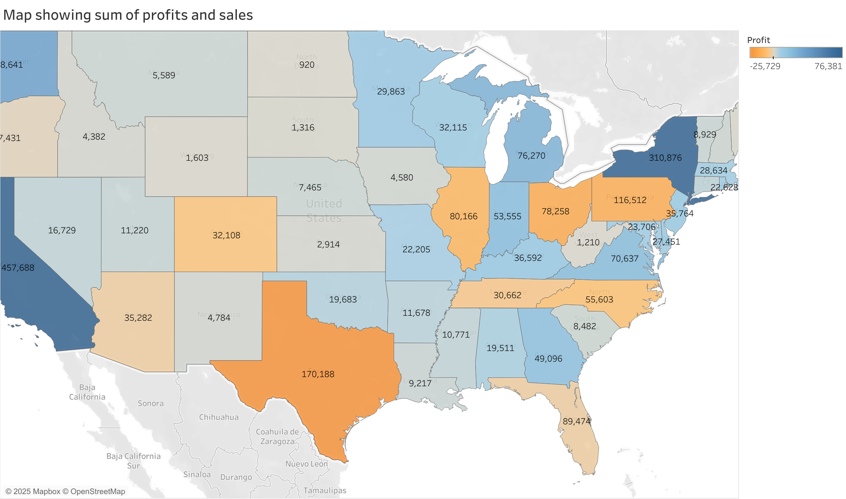

Slide 6
